Slide 1


Slide 2
CSE 5324 | Summer 2014
July 3, 2014
Submitted By:
Akshay Ratnaparikh
Jyoti Salitra
Wesley Mao
Anand Kadia
Sneha Kulkarni

Slide 3
DOMAIN: BOOKSTORE
INITIAL REQUIREMENT:
Product search (basic and advanced). a. In basic search, a textbox where user can enter any search text. b. In advance search, allow users to choose the product attributes (e.g. product name, size, price, etc ) to search and display, along with options on how the results are to be displayed - in ascending or descending order.
Display clickable listing of results. a. Users can click one result and it brings them to a new page for that particular product.
Navigation pane on the left side of the UI, for different product category. Each clickable link will display all the products of that category.
MRSK2.OVERVIEW.PROJECT DESCRIPTION & REQUIREMENT

Slide 4
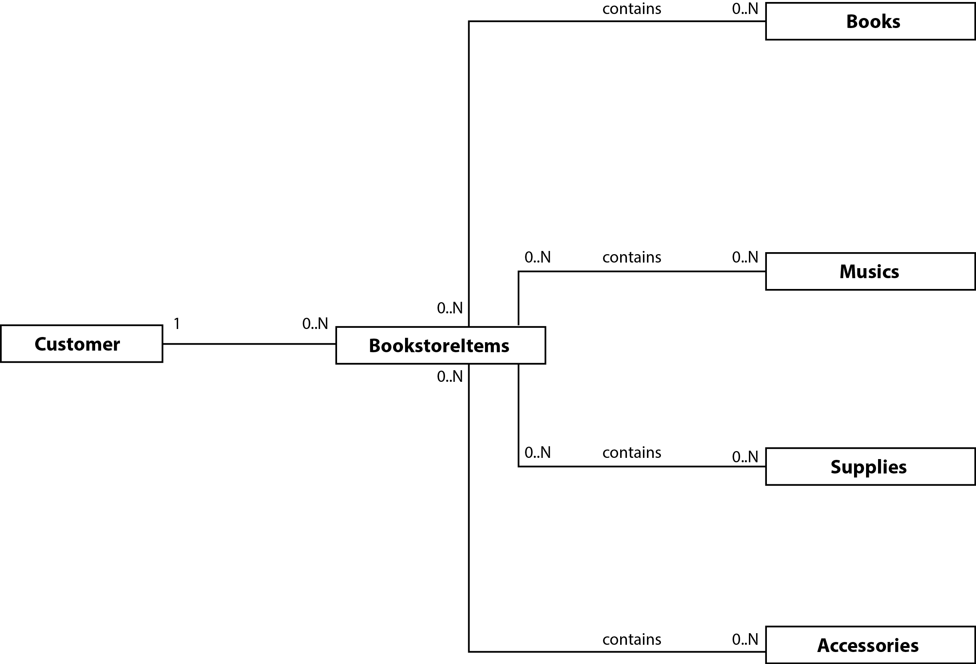
MRSK2.OVERVIEW.DOMAIN DIAGRAM

Slide 5
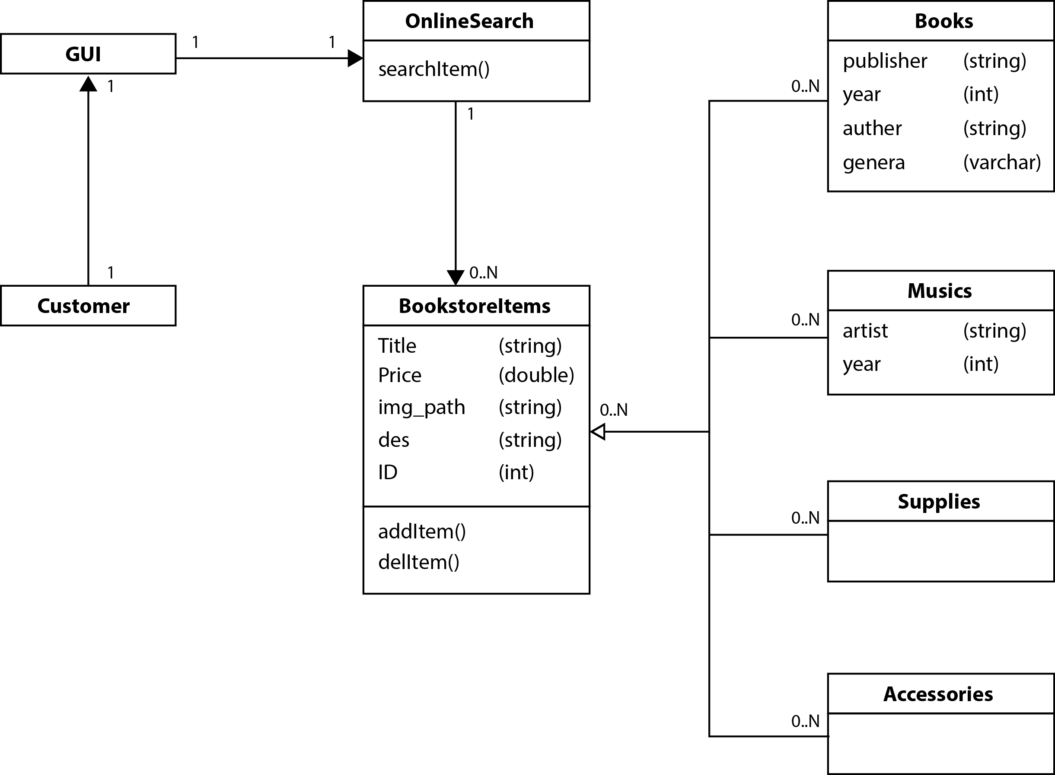
MRSK2.OVERVIEW.CLASS DIAGRAM

Slide 6
V
C
M
MRSK2.OVERVIEW.CLASS DIAGRAM

Slide 7
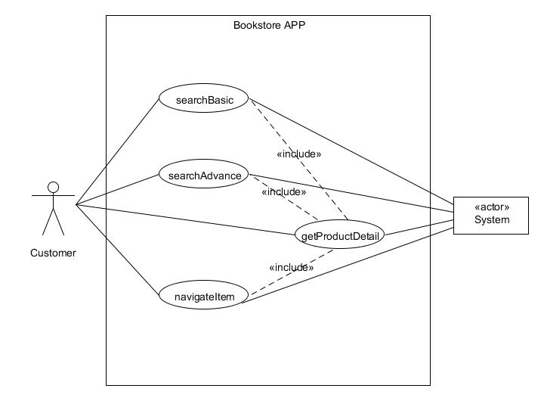
MRSK2.OVERVIEW.USE CASE DIAGRAM

Slide 8
 | IMPORTANCE (1:low 10:high) | TECHICAL DIFFICULTTY (1:low 10:high) | TIME REQUIRED (1:long 10:short) | OVERALL SCORE
searchBasic | 5 | 7 | 6 | 18
searchAdvance | 3 | 10 | 2 | 15
navigateItems | 10 | 1 | 6 | 17
getProductDetails | 1 | 1 | 7 | 9
MRSK2.OVERVIEW.RISK MATRIX

Slide 9
USE CASE 01 – searchBasic
MRSK2.OVERVIEW.USE CASE 1

Slide 10
MRSK2.OVERVIEW.USE CASE 1.SPECIFICATION

Slide 11
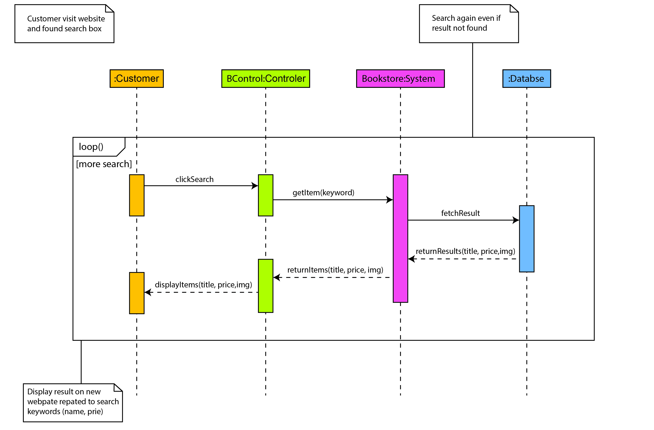
MRSK2.OVERVIEW.USE CASE 1.SEQUENCE DIAGRAM

Slide 12
MVC Solution
Controller
Java Servlet
Java
MySql
JSP
HTML
JavaScript
Model
Database
View
MRSK2.Development.USER INTERFACE

Slide 13
View
Technologies Used
BootStrap
To make it responsive on every screen.
HTML/CSS
To get stylish effects
Java Script
To make the web page more interactive.
JSP and JSTL
To make the web pages dynamic.
JSTL provides an effective way to embed logic within a JSP page without using embedded Java code directly
MRSK2.Development.USER INTERFACE

Slide 14
HTML5:
All the layouts are developed using HTML5. We have used new semantic elements like header, nav, section etc.
Styles:
External CSS stylesheets are used for styling the page.
Bootstrap 3.2.0 CSS framework for grid system, forms, tabs, and navigation.
Glyphicons (font-icons) for icons like search, menu etc.
Responsive user interface that fits properly to most of the devices including smartphones, tablets, and desktops.
@media query breakpoints for responsiveness:
480px, 768px, 992px, and 1200px
MRSK2.Development.User Interface.TECHNOLOGIES

Slide 15
3. Scripts
jQuery v 1.11.1 JavaScript library.
Search results are categorized using JavaScript code with event handlers and filters.
4. Images:
Product images are stored in WebContent img directory and paths are stored in the database.
Images are optimized for .PNG file format.
Browser Support:
The application supports all modern browsers like Chrome, Firefox, Internet Explorer, Safari, mobile Chrome, and mobile Safari.
For older IE versions (<IE9), JavaScript libraries like html5shiv and respond.js are used. These libraries are loaded (for <IE9) using conditional statements.
MRSK2.Development.UserInterface. TECHNOLOGIES

Slide 16
SERVER SIDE APPLICATION
MRSK2.Development.SERVER

Slide 17
Tools and Technologies:
WebServer: Apache Tomcat
Java Platform, Enterprise Edition (J2EE)
Database: MySQL
Other libraries: mysql-j-connector, JSTL
IDE: Eclipse Kepler
JRE 7
MVC Architecture:
Model: Java POJO (Plain Old Java Object); represents a database record in Java environment. e.g. SearchResultModel class.
View: Java Server Pages; compiled by Web Server into HTML and return to the client.
Controller: Servlets; handle request/response and control the processing among server side resources. e.g. BasicSearchServlet
MRSK2.Development.SERVER

Slide 18
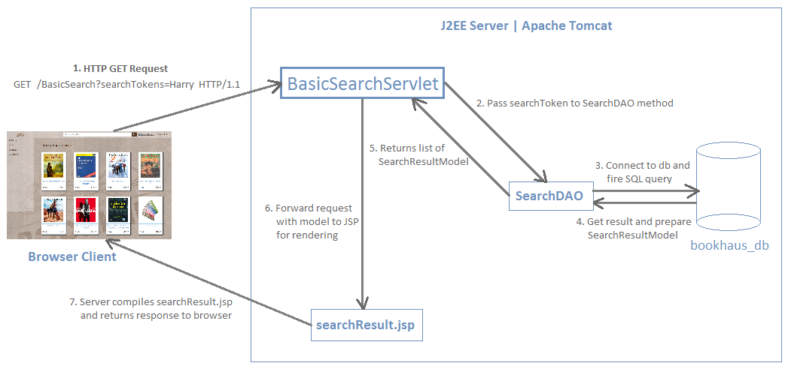
MVC Flow Chart
MRSK2.Development.SERVER

Slide 19
Database
MRSK2.Development.Database

Slide 20
Importance of choosing the right database
High cost for an enterprise system
Databases can hold the “keys to the castle”
Databases can give companies a competitive advantage
MRSK2.Development.Database

Slide 21
Which is better?
MySQL
For non mission-critical environments
Great for database enabled websites
Attractive price point
Oracle
Rock solid dependability, reliability, and features
Steep learning curve and expensive
Designed with the enterprise in mind
MRSK2.Development.Database

Slide 22
MySQL Features
Easy to get started with
Many free GUI management tools like PHPMyAdmin
Uses very little overhead
MySQL uses just under 1MB of RAM on laptop
Oracle 9i installation uses 128MB while idle
Beginning to support advanced features
Stored Procedures, Triggers, Views
Select statements with sub-queries
Transactional tables
Cascading updates and deletes
MRSK2.Development.Database

Slide 23
Database operations for Basic Search
Database creation
Relations (tables) creation
Java class to connect with database
Connection conn = DBManager.getConnection();
MRSK2.Development.Database

Slide 24
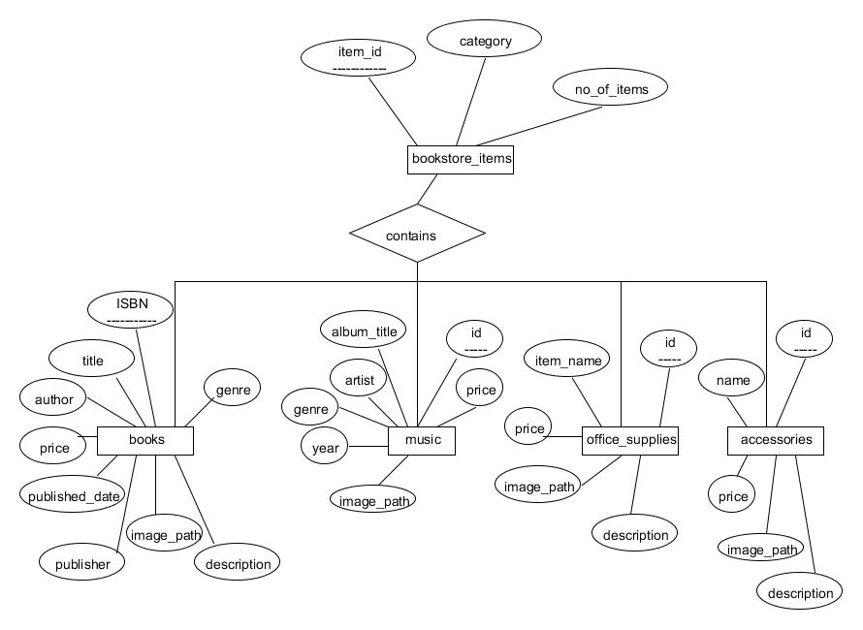
ER-Diagram
Database creation
Relations (tables) creation
Java class to connect with database
Connection conn = DBManager.getConnection();
MRSK2.Development.Database

Slide 25
SQL query for basic search
private final String BASIC_SEARCH=
"SELECT ID as id, TITLE as title, PRICE as price, IMAGE_PATH as imagePath, 'Books' as category FROM bookhaus_db.books where TITLE LIKE ?"
+ " UNION“
+ " SELECT ID as id,NAME as title, PRICE as price, IMAGE_PATH as imagePath, 'Accessories' as category FROM bookhaus_db.accessories where NAME LIKE ?“
+ " UNION“
+ " SELECT ID as id, ALBUM_TITLE as title, PRICE as price, IMAGE_PATH as imagePath, 'Music' as category FROM bookhaus_db.music where ALBUM_TITLE LIKE ?“
+ " UNION“
+ " SELECT ID as id, ITEM_NAME as title, PRICE as price, IMAGE_PATH as imagePath, 'Office Supplies' as category FROM bookhaus_db.office_supplies where ITEM_NAME LIKE ?";
MRSK2.Development.Database

Slide 26
Demo

Slide 27
Thank You

